Slide 1

Team Easy-techies
Naman Sethi
Aavani Perumbessi
Om Tripathi
Arsheel Patel

Slide 2
Problem Statement
There's a million sources of financial advice and investment recommendations on the internet. Can people have their own personalized AI-powered one?

Slide 3
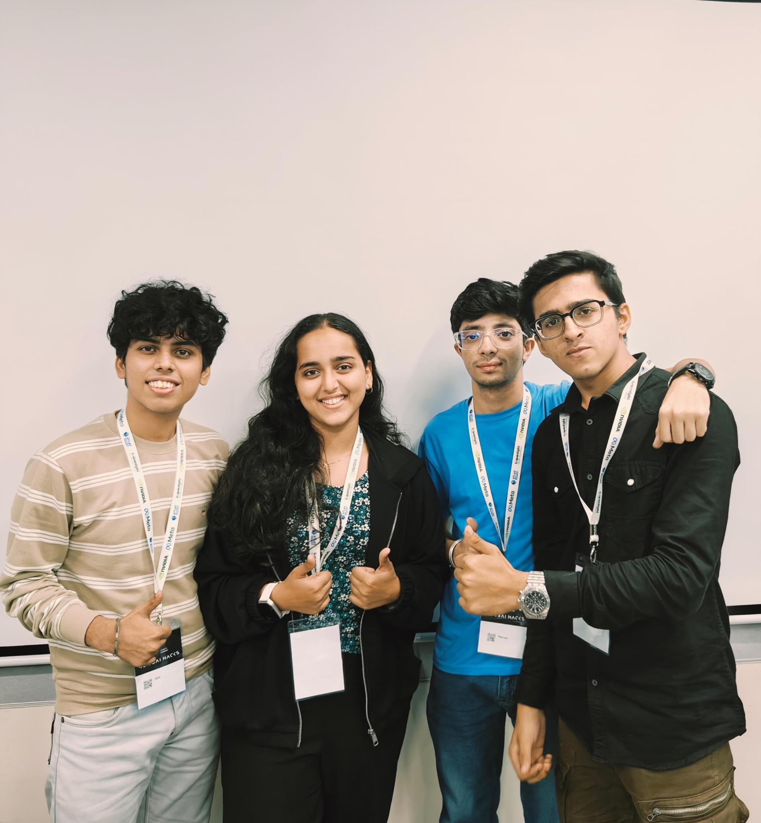

Slide 4
Solution :
StockSense is an AI-powered stock trading app that helps both new and experienced investors make smarter investment choices. Users can set budgets, receive personalized stock recommendations, and access tailored insights, all through a sleek, easy-to-use interface.

Slide 5
THANK YOU

